Slide 1
ASHRAE - Great Energy Predictor III How much energy will a building consume?
More Buildings Make More Generalizable Models—Benchmarking Prediction Methods on Open Electrical Meter Data, Miller
김영현
2019/11/09

Slide 2
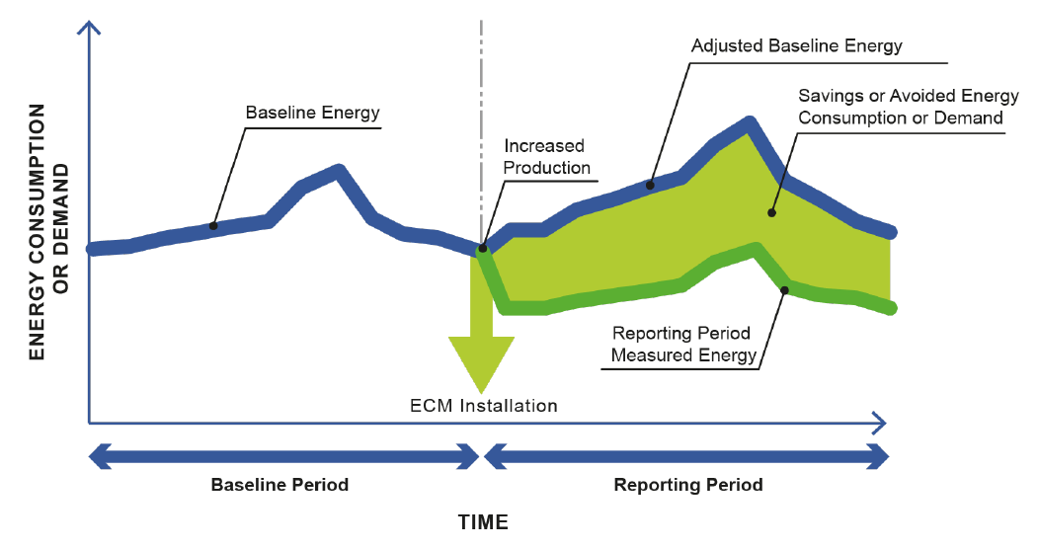
목적
건물의 에너지 사용량 예측
에너지를 절약하기 위함
From [1]

Slide 3
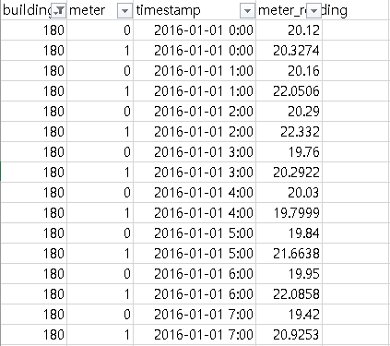
데이터 특징 (1)
시계열 데이터
회귀 분석

Slide 4
데이터 특징 (2)
거주지 및 비거주지 혼합
Banking/financial services, Education, Entertainment/public assembly, Food sales and service, Healthcare, Lodging/residential, Manufacturing/industrial, Mixed use, Office, Parking, Public services, Religious worship, Retail, Technology/science, Services, Utility, Warehouse/storage, other.

Slide 5
고려할 사항 (1) - 스케쥴
하루의 어느 시간에 건물이 활성화 되는가?
사무실 : 9 a.m. – 6 p.m, 호텔 : 6 p.m. to 10 a.m. etc.
주중과 주말의 차이
방학이나 공휴일 등의 휴일
여름 방학, 겨울 방학
부활절, 추수감사절 등
Time-series methods
Notes:
The concept of scheduling in non-residential buildings is most often related to the predefined schedules programmed into the automation systems in the building, unlike the human behavior that is discussed later. These schedules are determined usually by the operations and maintenance policy or by the energy management group within an organization. Many buildings have very predictable schedules, while others are much more volatile. Modeling such behavior can often be done using time-series methods that find auto-correlation behavior or by using date/time features as inputs to prediction models.

Slide 6
고려할 사항 (2) - 사람
스케쥴과 비슷하나 stochastic 성격이 강함.

Slide 7
고려할 사항 (3) - 날씨
난방, 환기 및 공조는 에너지 소비량의 상당 부분을 차지.
이러한 요소들은 날씨에 영향을 많이 받음.
건물의 자재에 따라 주는 영향도 다양.
Changing Point Models [4] / time-of-week indicator and temperature [5]
Notes:
Time-of-day 나 day-of-week indicator variables대신 (단 time의 interval은 15분)
Piecewise linear and continuous outdoor air temperature dependence

Slide 8
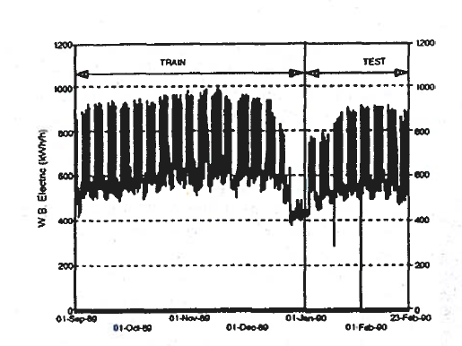
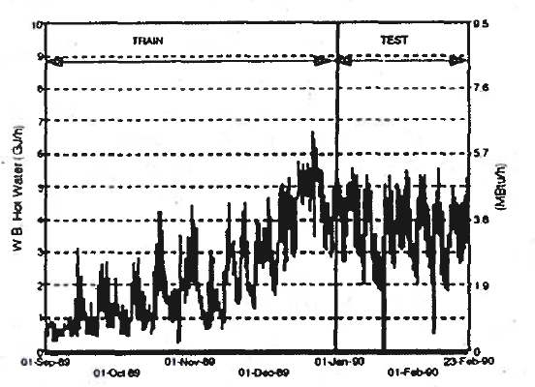
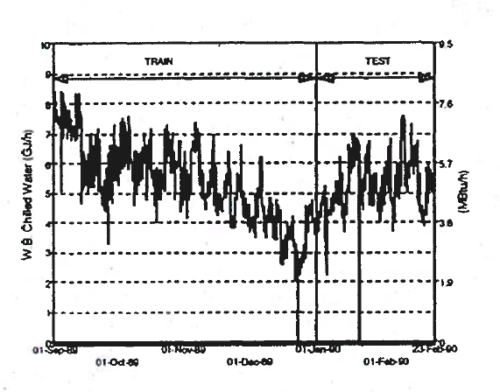
고려할 사항 (4) - 불규칙적인 이벤트
일정 변동, 고장 등 불규칙적인 이벤트
Changing Point Prediction
From [3]
Notes:
89년 12월 22-23일 텍사스에 위치한 캠퍼스의 whole building electricity.

Slide 9
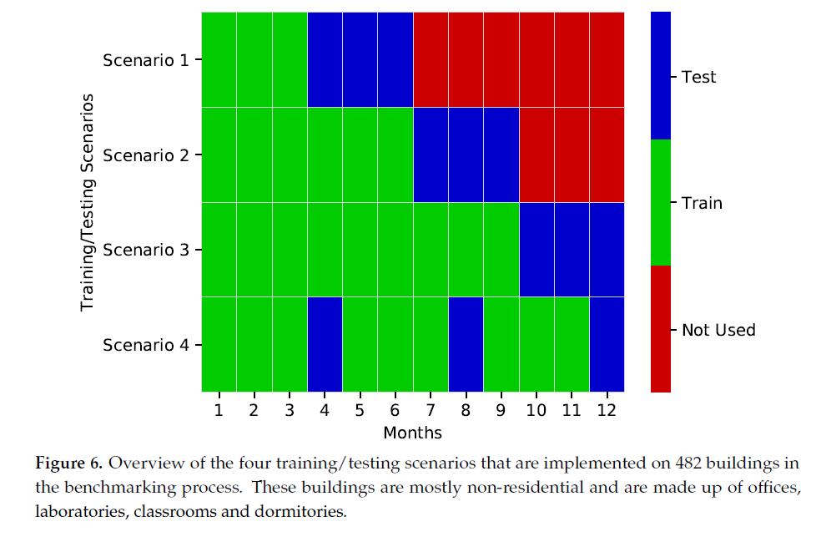
데이터 셋 시나리오
From [1]

Slide 10
Discussion (From [1])
Long-Term versus Short-Term Forecasting Applications
On the Need for Generalizability of Building Performance Forecasting in Various Applications
Potential Future Enhancements of the Benchmarking Process
Testing Model Hyperparameters in the Benchmarking Process
Using More Advanced Time-Series Prediction Techniques [6]
Transfer Learning: Using Training Data from the Whole Population for Prediction of Each Building
Automated Feature Extraction and Deep Learning Methods
Finding Additional Phenomena to Measure or Collect that Can Be Used as Input for the Modeling Process
Focus on the Accuracy of a Modeling Framework Rather Than an Individual Model
Integration of Data-Driven Modeling with Physics-Based White-Box Modeling

Slide 11
참고
[1] Miller, Clayton. "More Buildings Make More Generalizable Models—Benchmarking Prediction Methods on Open Electrical Meter Data." Machine Learning and Knowledge Extraction 1.3 (2019): 974-993.
[2] https://www.energystar.gov/buildings/facility-owners-and-managers/existing-buildings/use-portfolio-manager/identify-your-property-type
[3] Kreider, Jan F.. “Prediction Hourly Building Energy Use : The Great Energy Predictor Shootout - Overview and Discussion of Results.” (1994).
[4] Kelly Kissock, J.; Eger, C. Measuring industrial energy savings. Appl. Energy 2008, 85, 347–361.
[5] Mathieu, J.L.; Price, P.N.; Kiliccote, S.; Piette, M.A. Quantifying changes in building electricity use, with application to demand response. IEEE Trans. Smart Grid 2011, 2, 507–518.
[6] Deb, Chirag, et al. "A review on time series forecasting techniques for building energy consumption." Renewable and Sustainable Energy Reviews 74 (2017): 902-924.

